Slide 1
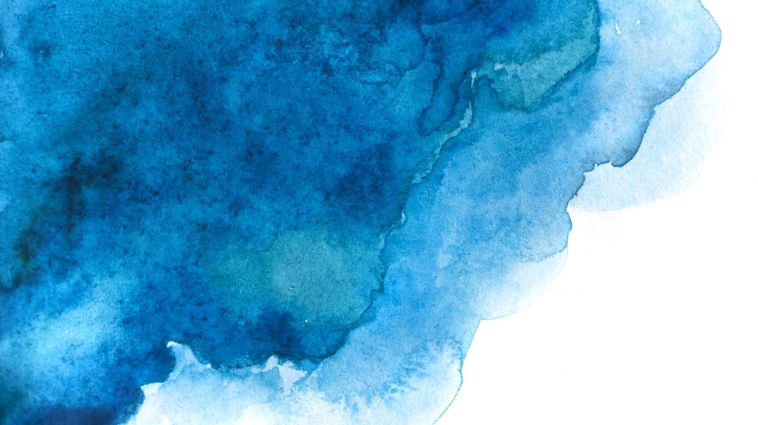
SonART
From sound to image

Slide 2
Goal and Applications
Create a tool that can support artists with automatically generated visuals from sounds that require little to no-effort to setup.
The ideal context is an art installation, but due to its general nature it can be used in various way, such as theaters.

Slide 3

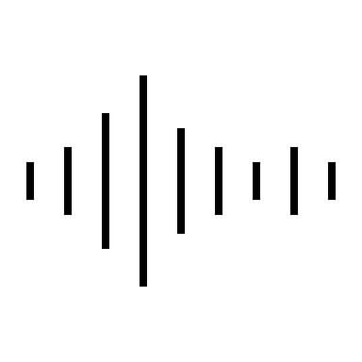
Current Implementation
YAMNET NEURAL NETWORK

Slide 4

Future Implementation
YAMNET NEURAL NETWORK
IMAGE GENERATION GAN

